Slide 1
MBA Admission Predictor Using Logistic Regression to Predict Admit vs. Deny Outcomes
Odeleye Stephen
March 2026

Slide 2
Problem Statement
Business schools receive thousands of applications each year
Manual review is time-consuming, subjective and resource-intensive
Objective: Build a machine Learning model to predict whether an applicant will be Admitted or Rejected based on key applicant features
Key Prediction Task: Binary Classification Admit(1) vs. Deny(0)

Slide 3
Dataset Overview and Cleaning Summary
Dataset Source: MBA Admission Dataset (Based on real statistics)
Key features(10 columns) – gender, gpa, gmat, major, race, admission, etc.
Data Size: 6000+ rows after cleaning
Cleaning Steps
Filled missing admission values with “Deny” and removed “Waitlist” columns
Encoded Categorical Variables:
gender: Male-1, Female-0
admission: Admit-1, Deny-0

Slide 4
Methodology
Model Chosen: Logistic Regression(Simple, interpretable and effective for binary classification)
Preprocessing Pipeline
Feature Encoding(One-hot encoding for categorical variables)
Feature Scaling using StandardScaler
Train-Test Split (80/20) with stratification on target variable
Model Training on scaled features
Tools and Libraries:
Pandas, numpy, scikit-learn
Seaborn, matplotlib for visualization

Slide 5
Model Results
Performance Metrics( Based on Test Set)
Accuracy: 84.82%
Precision: 46.48%
Recall: 18.33%
Interpretation:
The model is good at overall classification but shows lower recall
Suitable as a Screening tool rather than final decision maker

Slide 6
Key Visualizations and Insights
Major Insights:
Higher GPA and GMAT scores are the strongest positive predictors of admission
Applicants with work experience in Consulting and Finance show higher admission rates

Slide 7
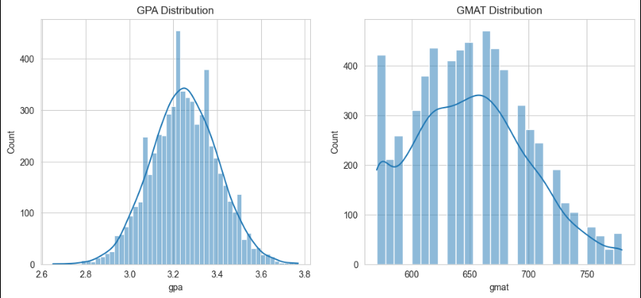
Distribution of GPA and GMAT Scores

Slide 8
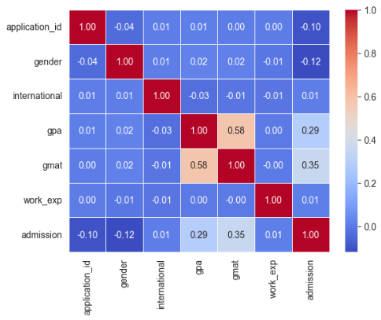
Correlation Matrix

